Slide 1
Markerless Augmented Reality Solo Fighting Game Using artificial intelligence
Name | Id | Role
Mohammad Fahim Hossain | 1520103042 | Scrum Master
Samiul Azim | 1531403042 | Team Member
Silvy Rahman Urmi | 1530794642 | Team Member
Abdullah khalid | 1410648642 | Team Member

Slide 2
Scope:
Work as a group using a particular software development process.
Get knowledge sofware enginerring displine, github uses.
Master mobile app development with augmented reality games in Android & IOS.
Realise the potential of Augmented Reality gaming in real world field tests.
Increase our skills in Unity 3D on a basic / intermediate level.
Understand how to use the Vuforia Augmented Reality package.
Increase your portfolio with augmented reality applications / games.
Understand the basics of C# with my step by step instructions on screen.

Slide 3
Agile project Management : Scrum It is an agile method that focuses on managing iterative development rather than specific agile practices.
Scrum benefits:
The product is broken down into a set of manageable and understandable chunks.
Unstable requirements do not hold up progress.
The whole team have visibility of everything and consequently team communication is improved.

Slide 4
Features :
Augmented reality : Augmented reality (AR) is an interactive experience of a real-world environment whereby the objects that reside in the real-world are "augmented" by computer-generated perceptual information.
The travel industry also has a lot to gain from the AR boom
By 2025 the healthcare revenue from augmented and virtual reality will be around $5 billion.
Vuforia Augmented Reality SDK : Vuforia is an augmented reality software development kit (SDK) for mobile devices that enables the creation of augmented reality applications.

Slide 5


Slide 6
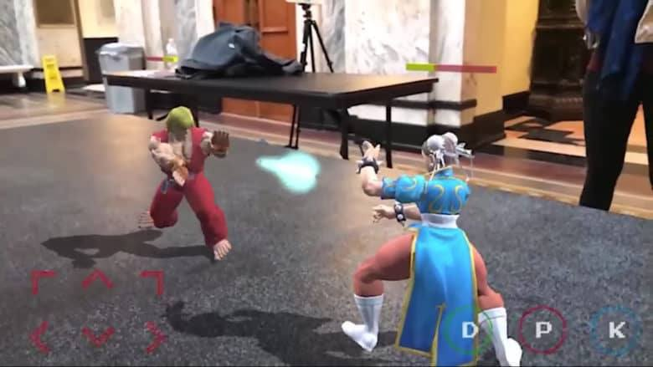
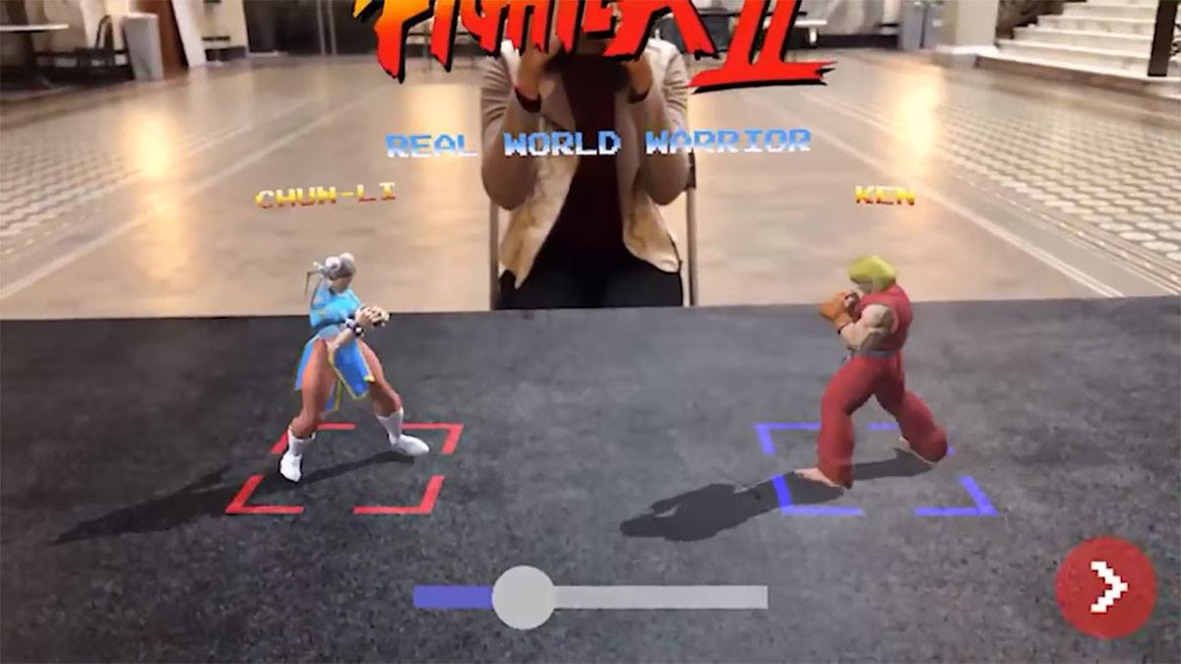
Artificial intelligence : In video games, artificial intelligence is used to generate responsive, adaptive or intelligent behaviors primarily in non-player characters (NPCs), similar to human-like intelligence.

Slide 7
scripting language : C#
We will use C-sharp language as our scripting language .
Much of the power of Unity is in its rich scripting language, C#. You can use it to handle user input, manipulate objects in the scene, detect collisions, spawn new GameObjects and cast directional rays around the scene to help with your game logic. It might sound intimidating, but Unity exposes well-documented APIs that make these tasks a breeze – even for novice developers.

Slide 8
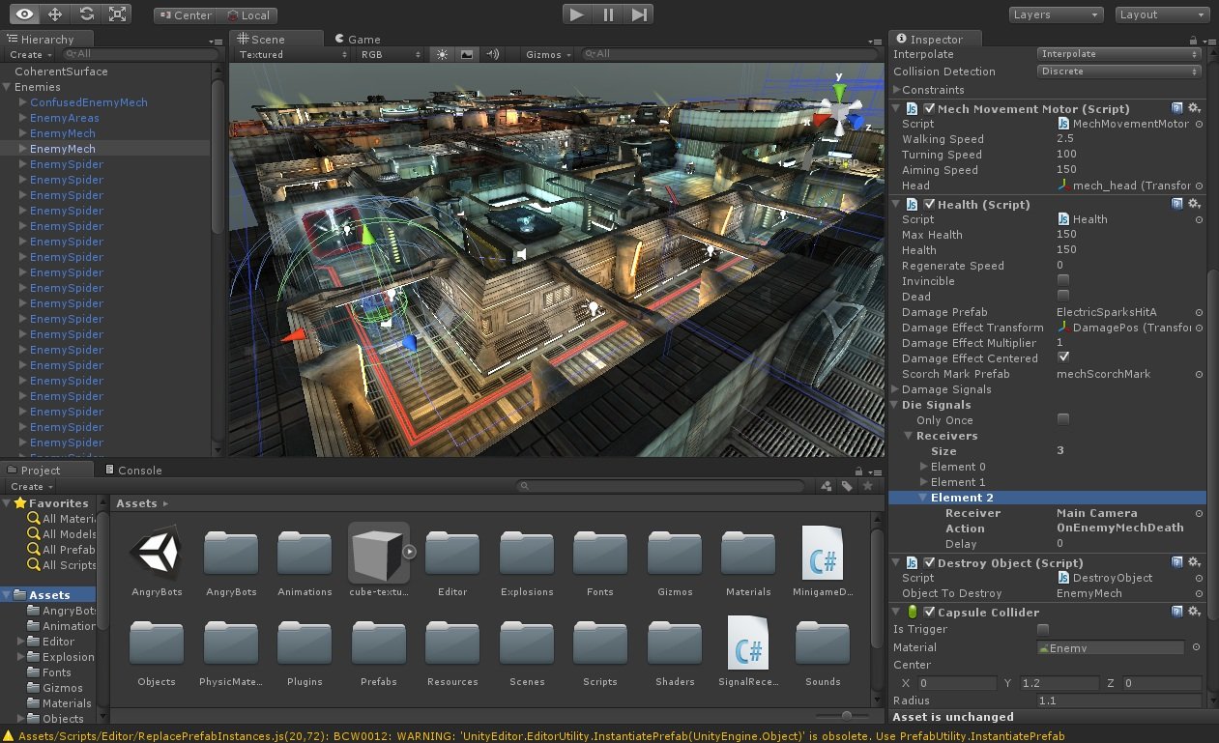
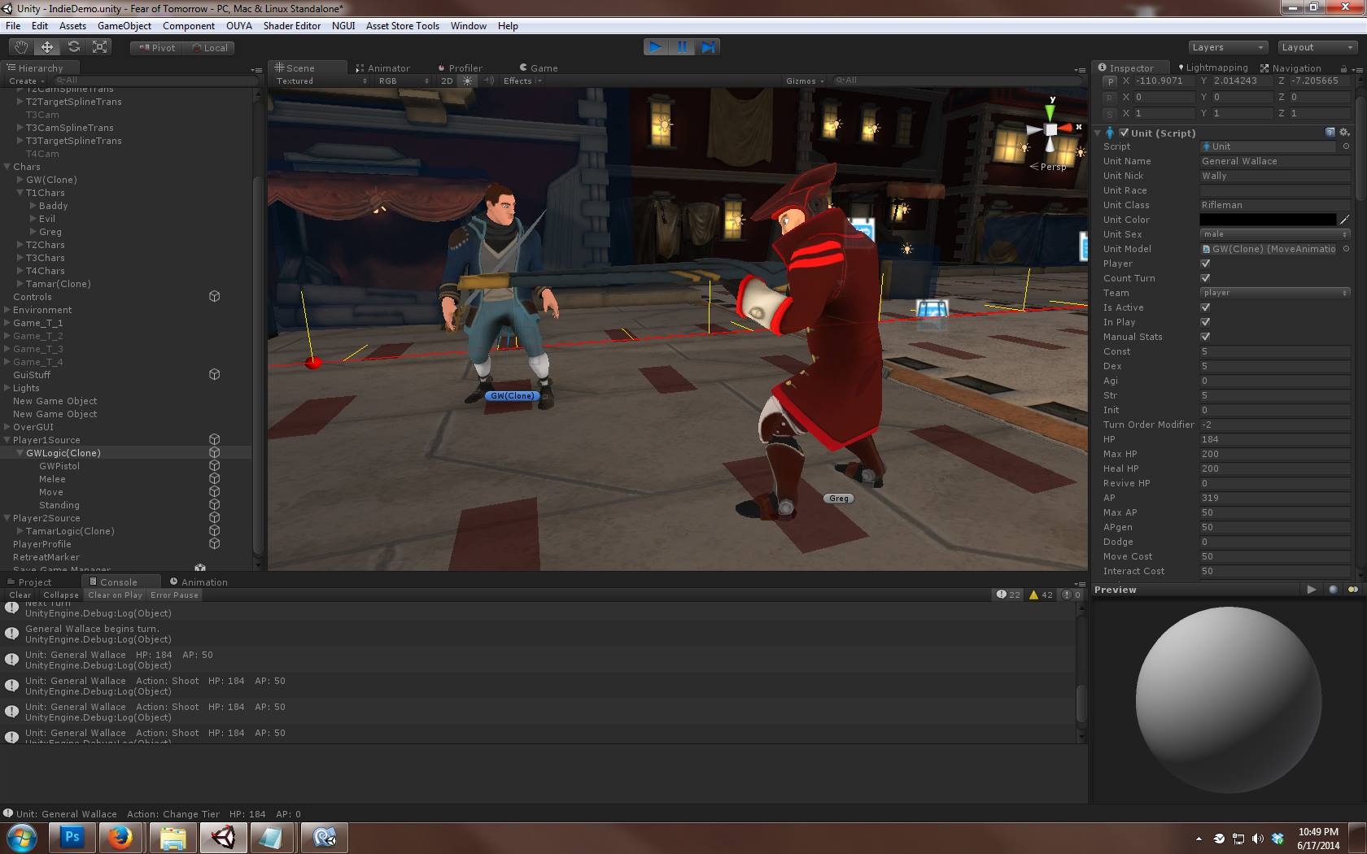
Unity Game Engine
Unity Game Engine : Unity is a cross-platform game engine developed by Unity Technologies,[4] first announced and released in June 2005 at Apple Inc.'s Worldwide Developers Conference as an OS X-exclusive game engine. We will use unity game engine version 2018.2 .

Slide 9
Pros of Unity Games Engines :
Platform support : The engine is highly preferred for its extended support to 27 platforms.
IDE : The text editor is provided by IDE to write the code, but sometimes a distinct code editor is also used by the developers to alleviate confusion.
Graphics : The high quality audio and visual effects are supported by the engine that eases the game development.
Documentation : It’s a must have. The novice developers need the easy-to-understand documentation that’s provided in detail by the Unity engine.
Debugging : The debugging and tweaking is amazingly easier with Unity game development.

Slide 10
Benefits of Playing Video Games:
You will make new social connections
You might get a career boost
They can help address autism
Improvements in attention and vigilance
Reduced impulsiveness
Improvements in executive functioning

